Slide 1
Quick Refreshresh on Graph Theory
By bipin sinha

Slide 2
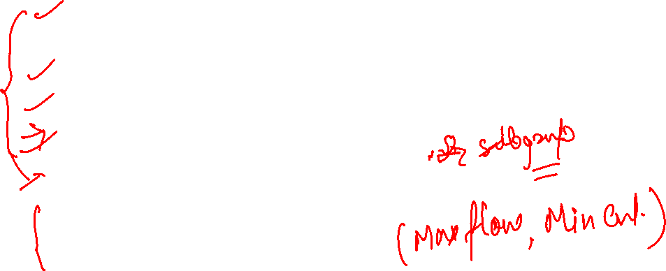
Agenda
HandShaking Theorem
Havel Hakimi Theorem For Degree Sequence of a Graph
Complement of a Graph in Graph Theory Discrete Mathematics
Euler Graph/Hamiltonian Graphs
Isomorphism in Graph Theory
Planer / Non-Planer Graph
Edge CutSet/Vertex CutSet

Slide 3
What is Graph Theory
Graph theory is a theoretical tool in the branch of discrete mathematics which deals with graph data structure and solves various problem related to graphs. Its interdisciplinary topic ranging from Network , biology, chemistry, finance , electrical engineering, mechanical engineering, physics, medical sciences, transportation, databases, electronic circuit etc.
We can convert the given problem in graph structure then by using graph theory as tool we can solve many problem by applying graph theory theorems and properties.

Slide 4


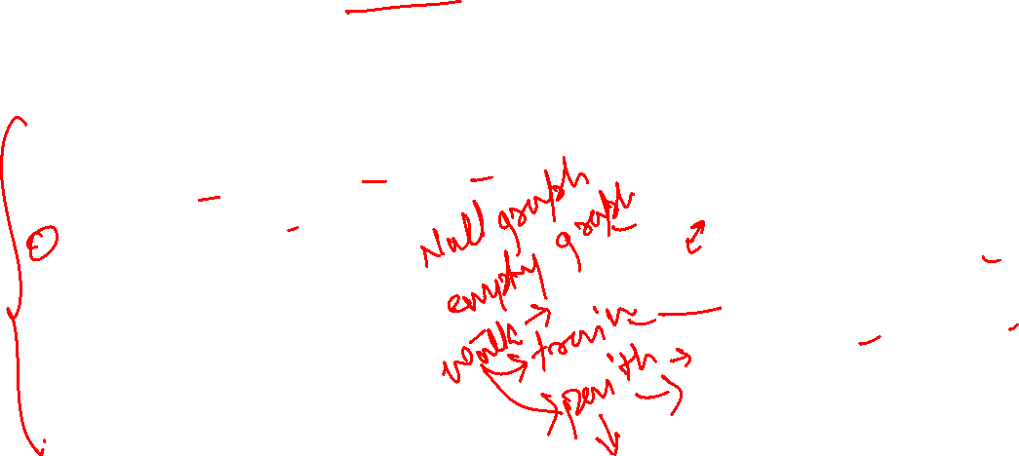
Recap Graph Data Structure Terminologies
In graph data structure following topics covered:
Graph data structure, Directed graph, undirected graph
Nodes/Vertices/Endpoints, Adjacent vertices, Pendent vertices, isolated vertices
Edges, Adjacent edges, Self-loop, Parallel edges
Directed graph, undirected graph
Degree of a vertex
Path, Simple path ,Cycle, simple cycle
Subgraph , Spanning Subgraph
Connected and Non Connected Graph
Adjacency Matrix, Adjacency List, Edge List
Breadth First Search (BFS), Depth First Search (DFS)
Graph Type | Self Loop | Parallel Edges
Graph
Multi-Graph
Pseudo-Graph
Simple-Graph

Slide 5
Important Definition
Note: Edge depends upon vertex but vertex do not depend on edges.
Graph is modelled as G(V,E) where V is set of vertices and Edge is set of edges
Infinite Graph are those graph where V and E set is infinite.
Finite Graph are those graph which has finite set of vertices and edges.
Null Graph are those graphs where edge set is empty
Trivial Graph are those graph where edge set is empty and vertices set has only one value.
Complete Graph are those simple graph where all vertices and connected with all other vertices.
Note: Edge depends upon vertex but vertex do not depend on edges.

Slide 6
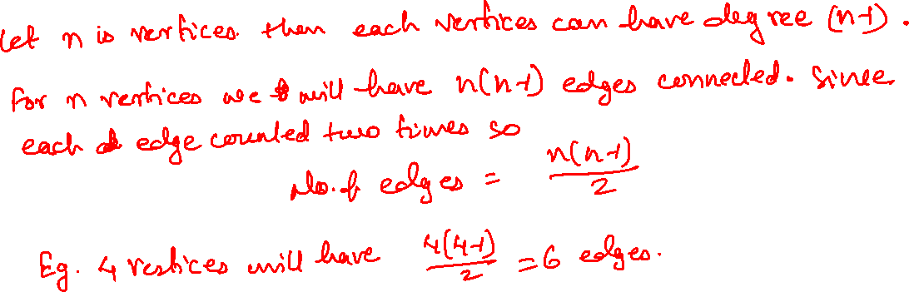
How to find number of edges in complete graph

Slide 7
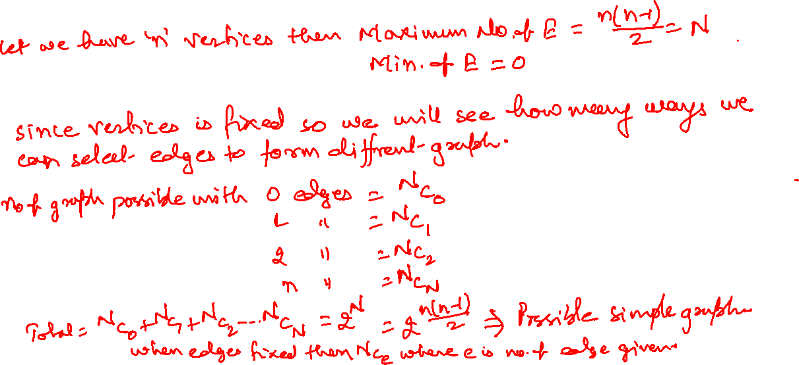
How to find number of simple graph based given vertices

Slide 8
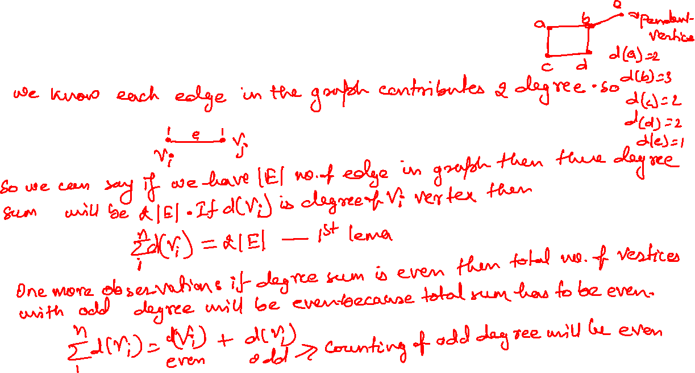
Handshaking/ Degree sum theorem

Slide 9
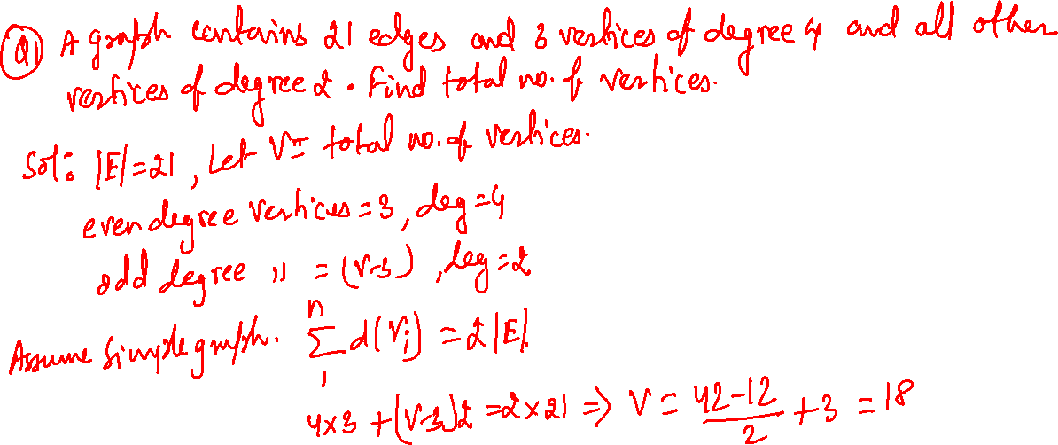
Practice Question(Handshaking lema)

Slide 10
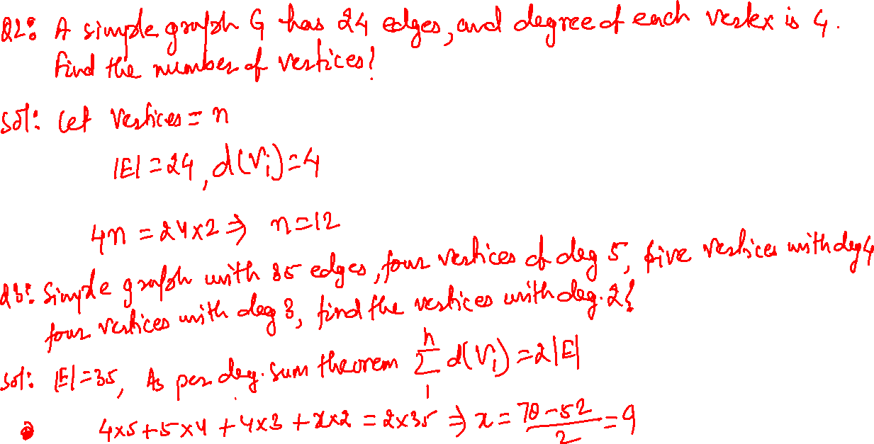

Slide 11
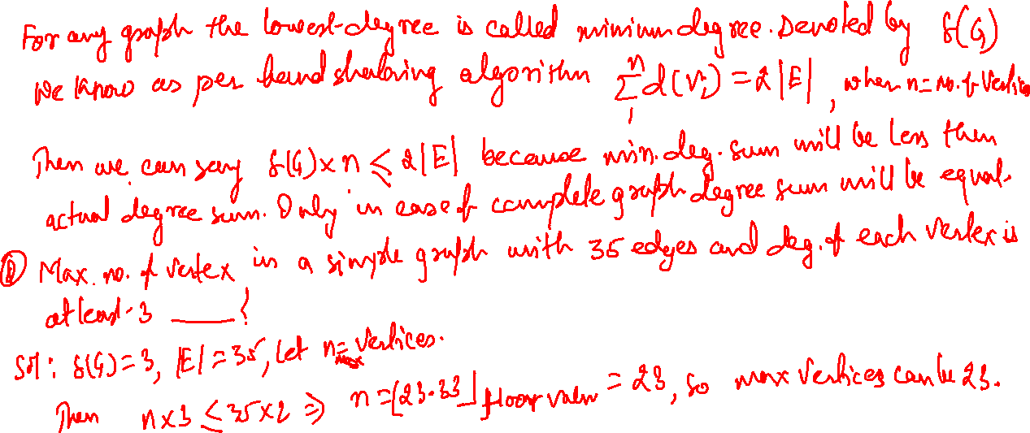
Minimum Degree Inequality relation

Slide 12
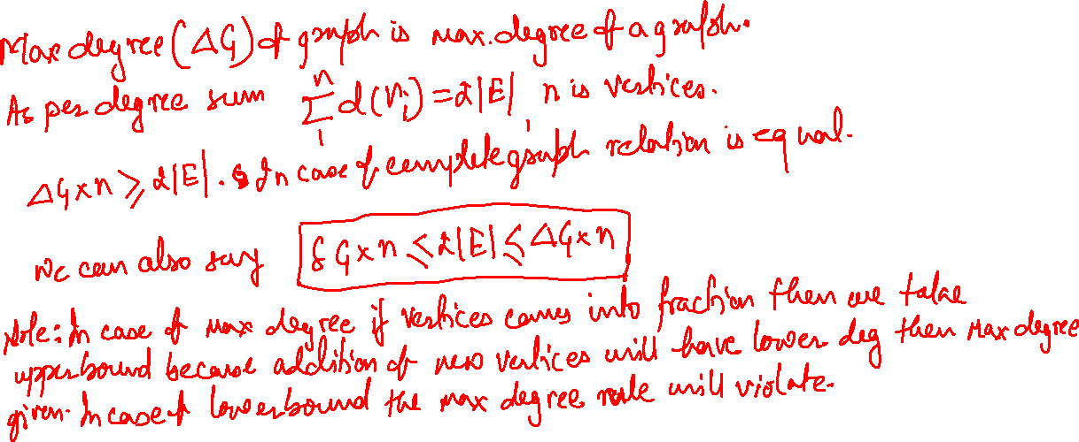
Max Degree Inequality relation

Slide 13
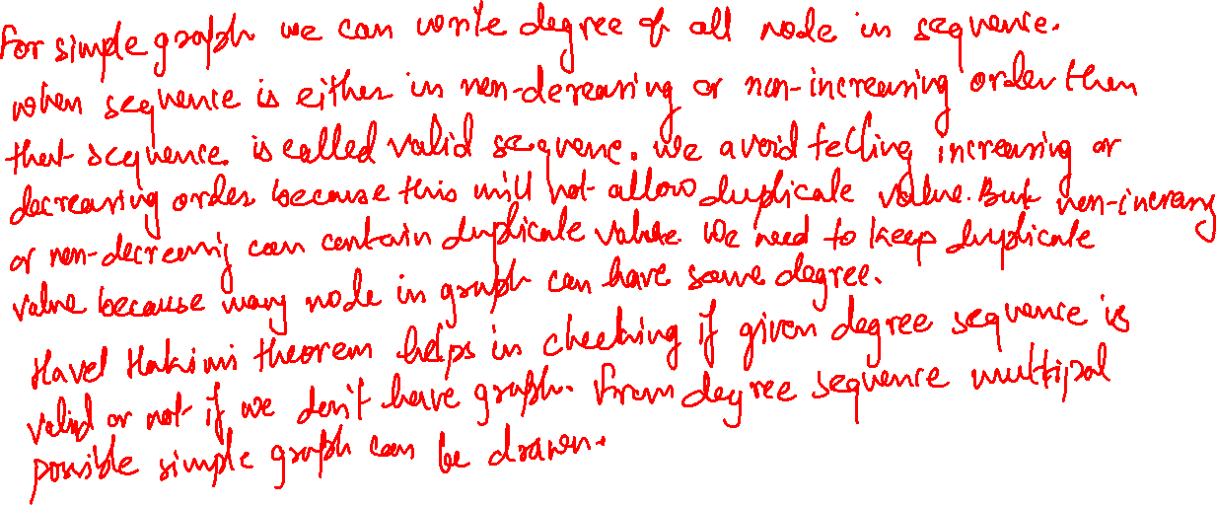
Degree Sequence and Havel Hakimi Theorem

Slide 14
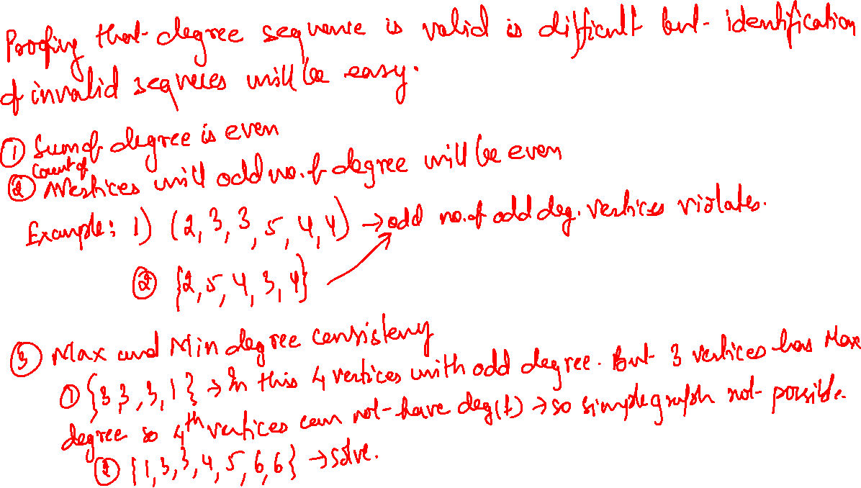

Slide 15
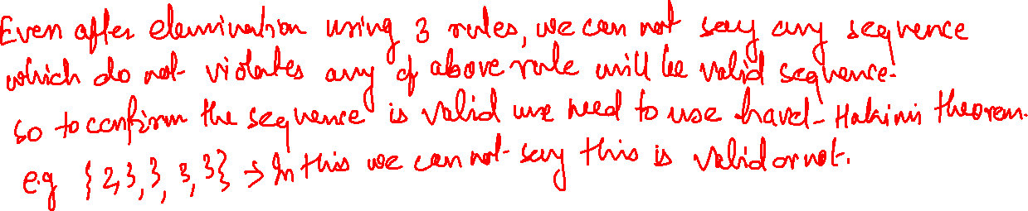
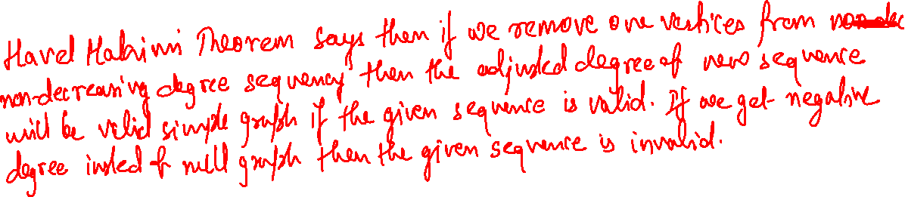
Havel Hakimi Thorem

Slide 16
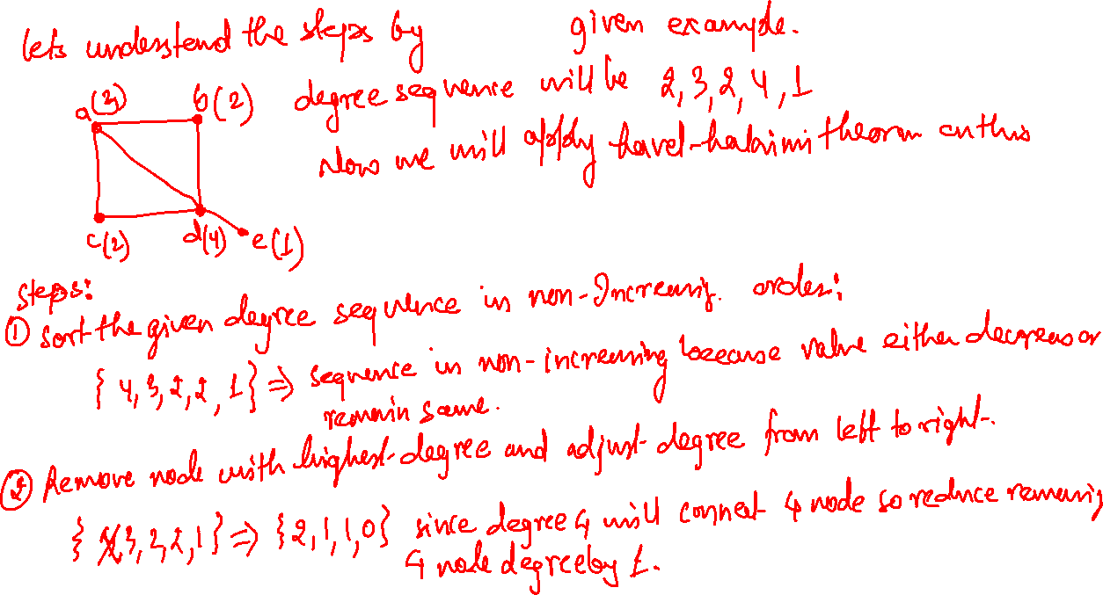

Slide 17
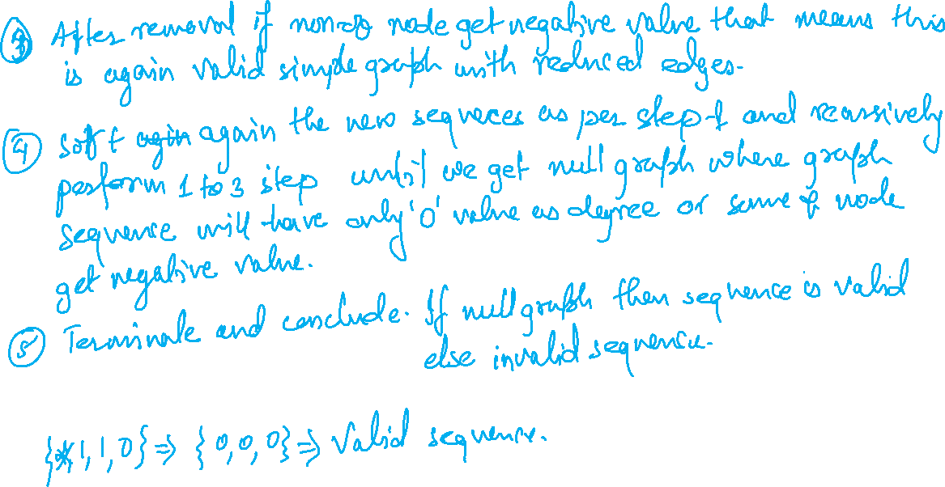

Slide 18
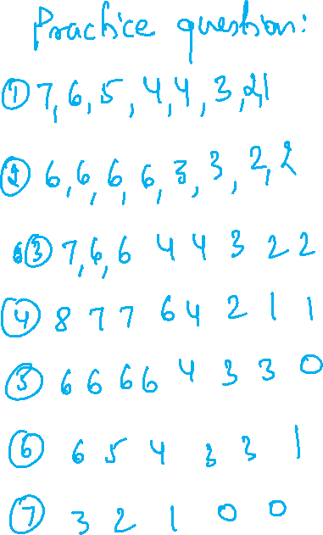

Slide 19
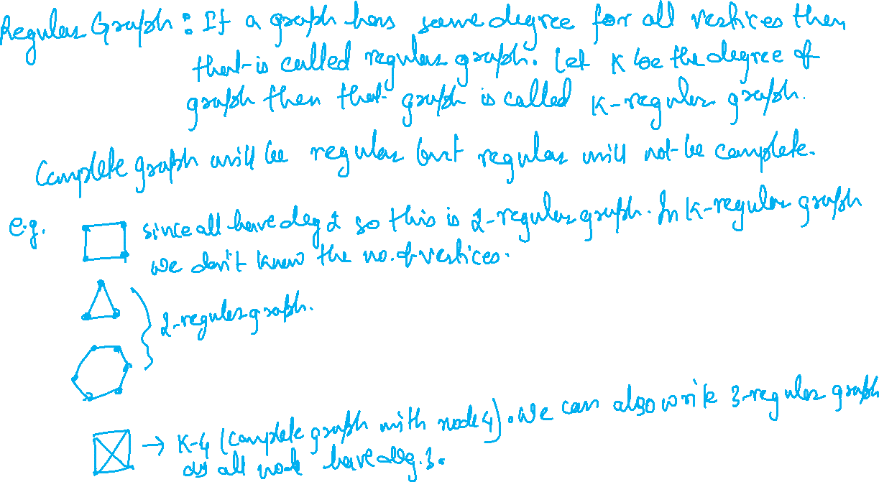

Slide 20
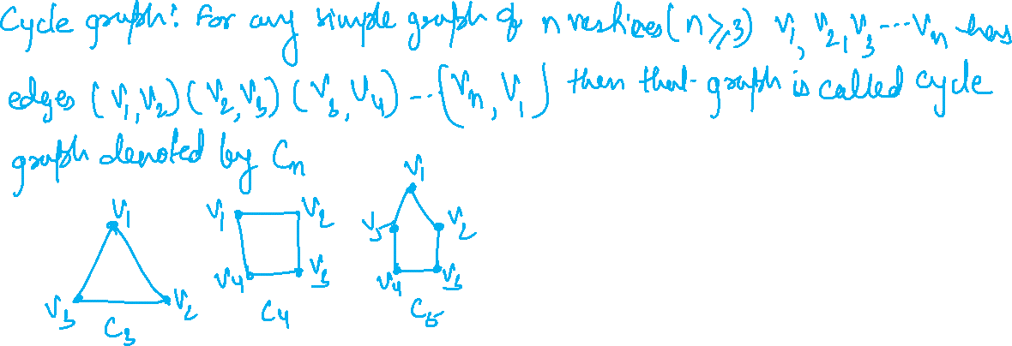
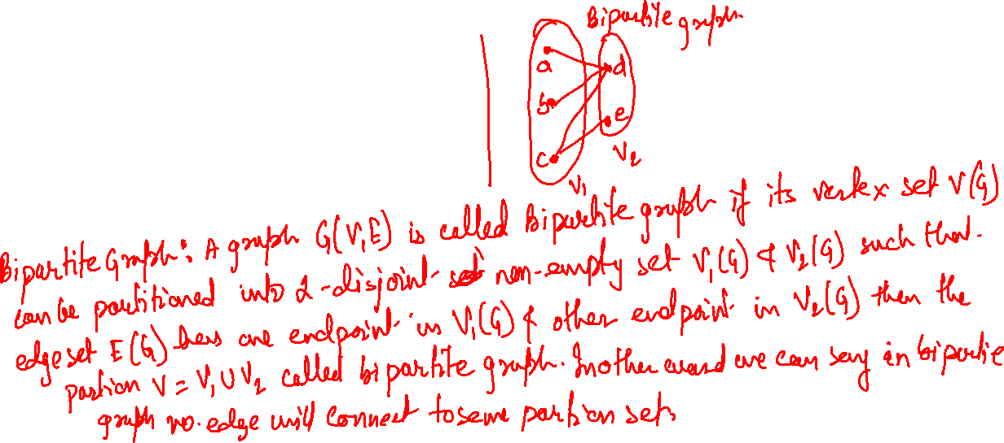

Slide 21
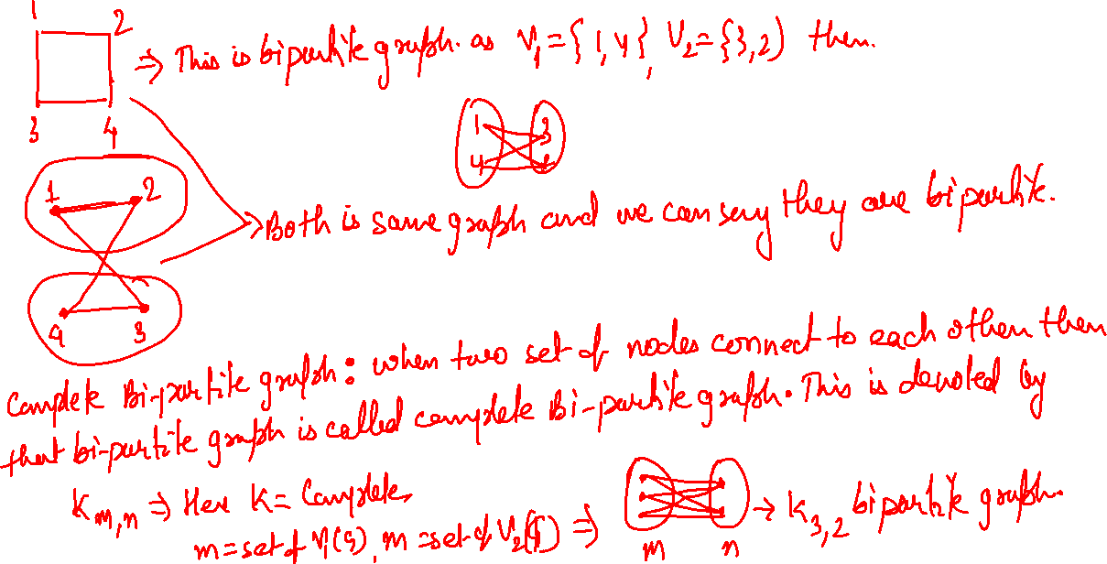

Slide 22
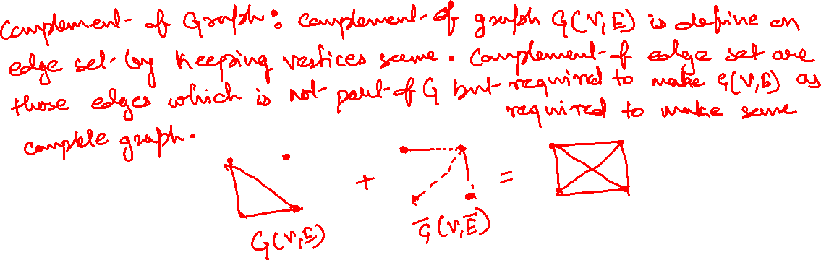
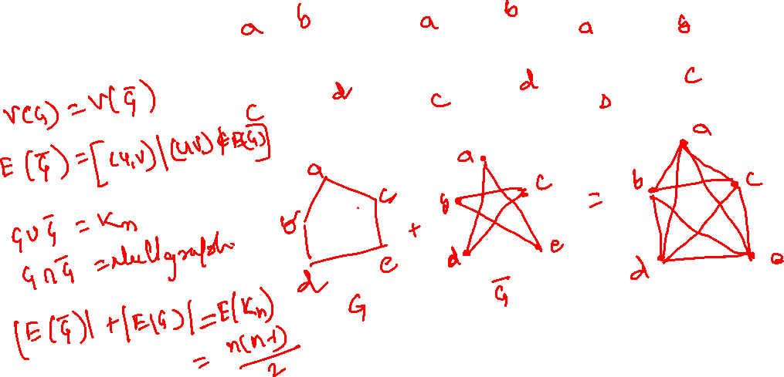

Slide 23
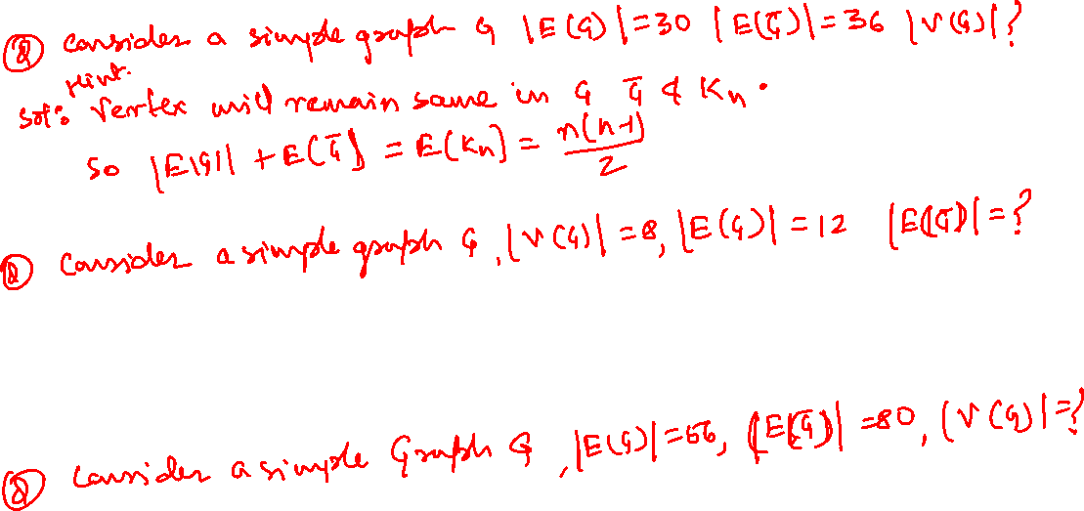
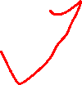

Slide 24

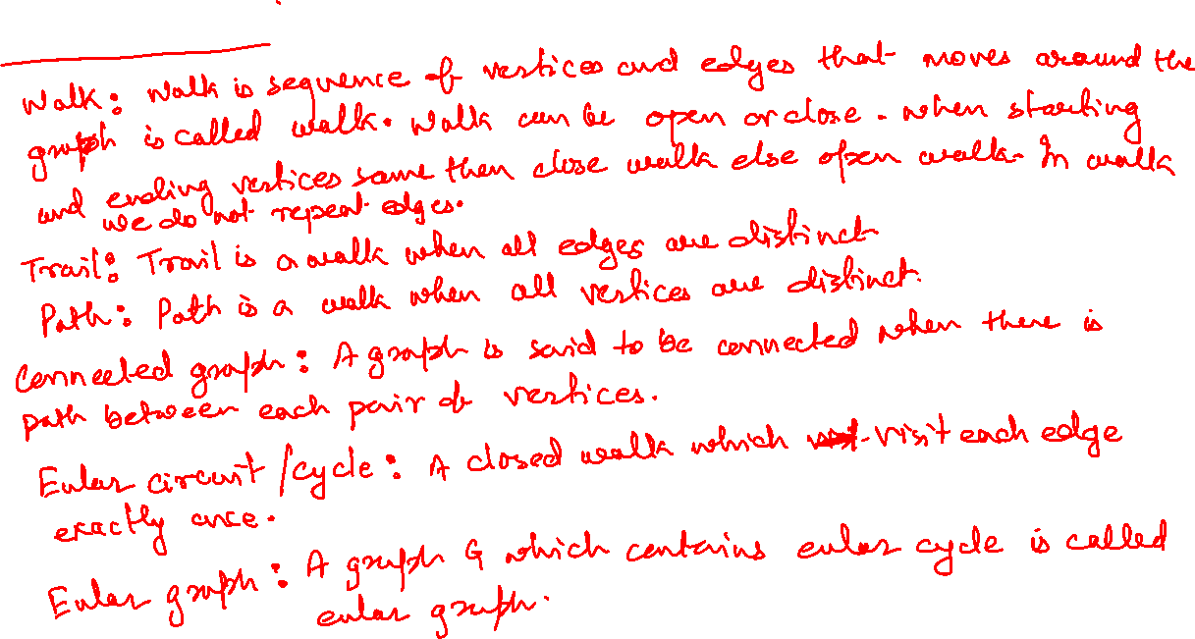

Slide 25
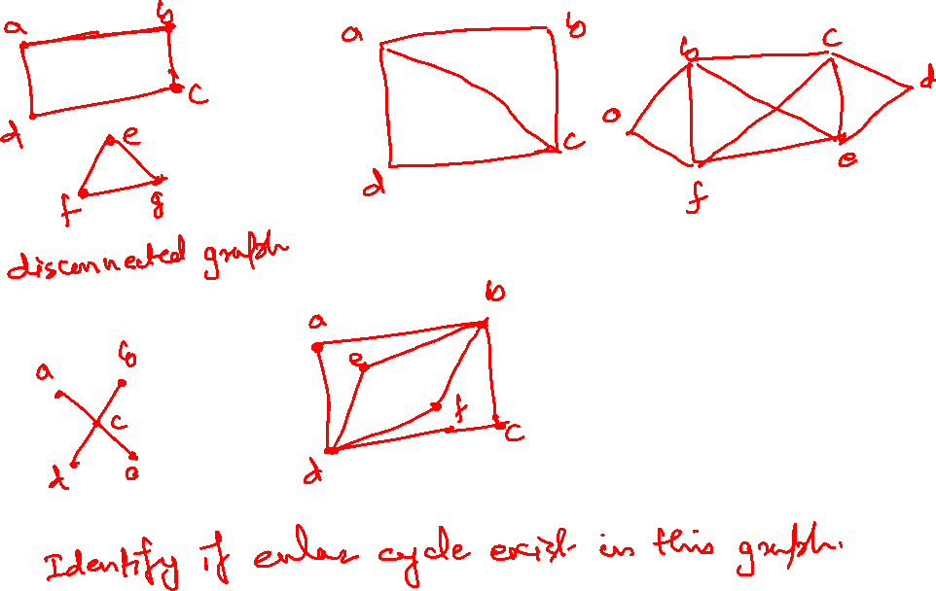

Slide 26
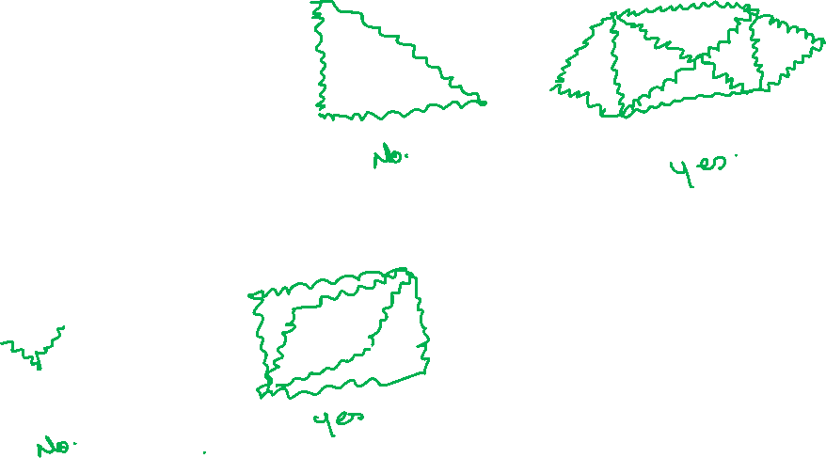

Slide 27
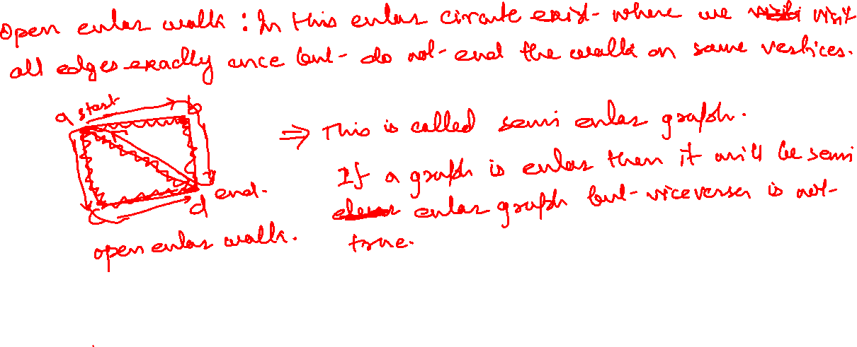

Slide 28
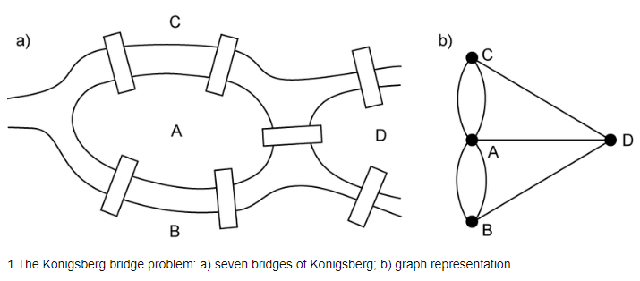
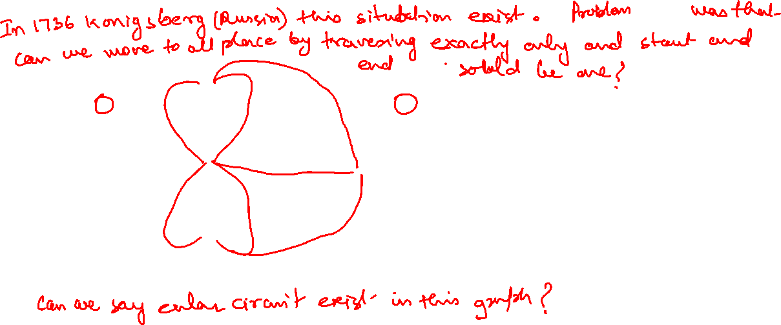
Seven Bridges of Konigsberg Problem

Slide 29
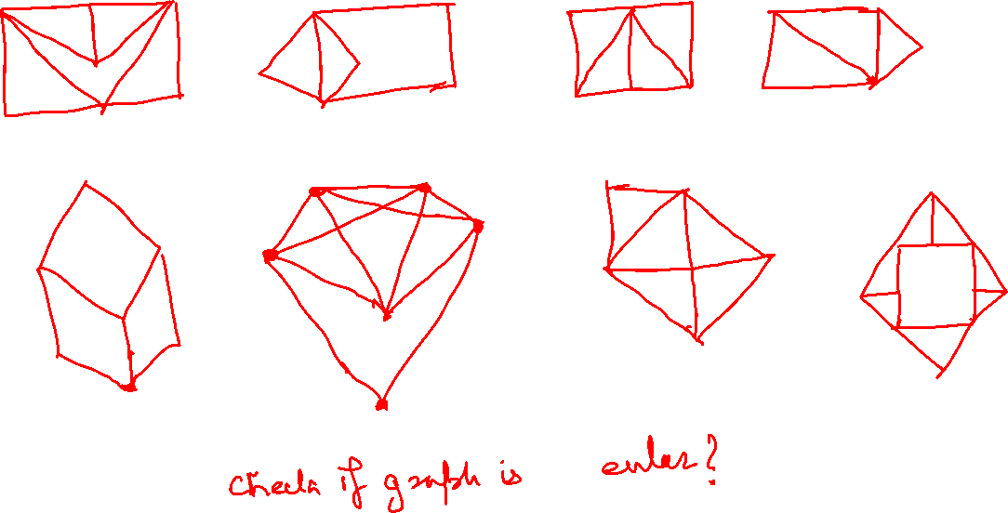

Slide 30
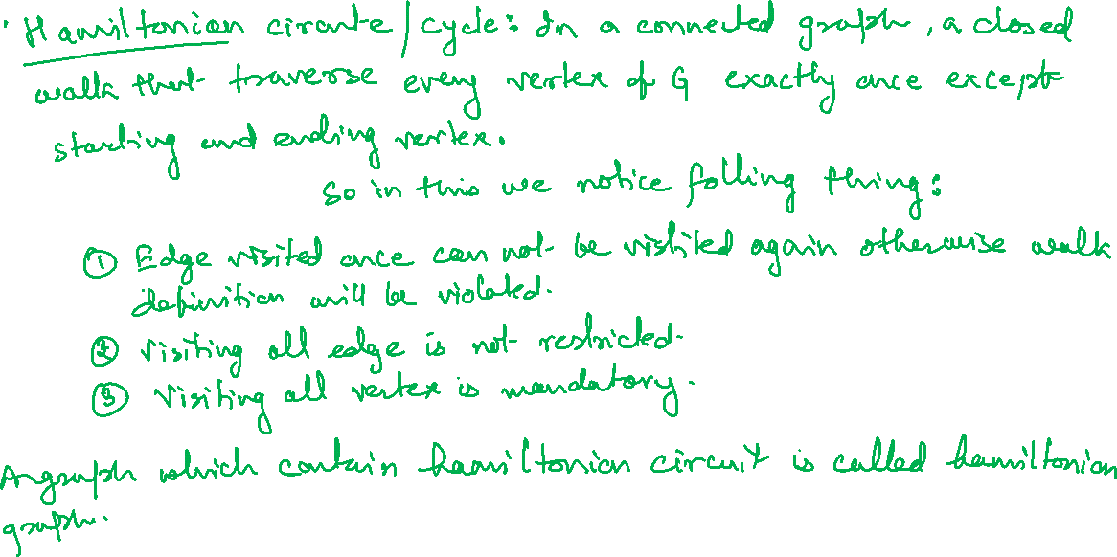

Slide 31
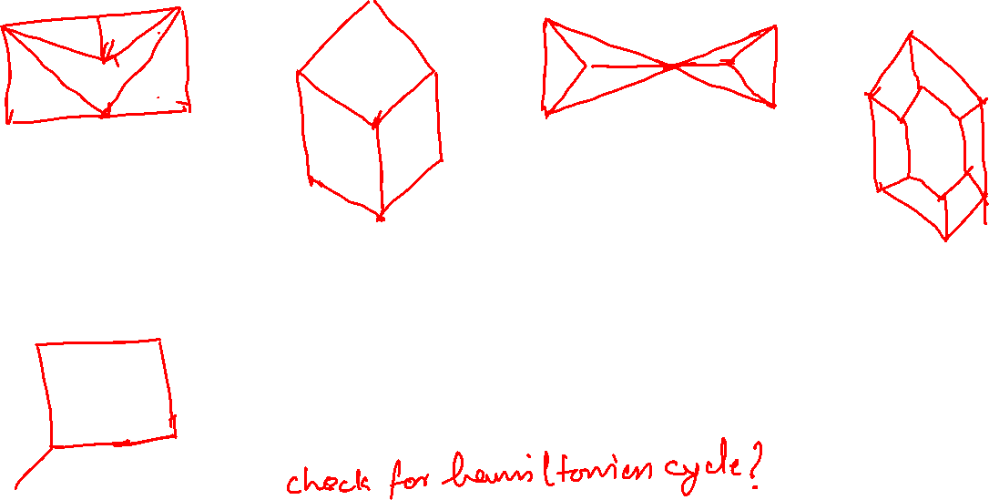

Slide 32
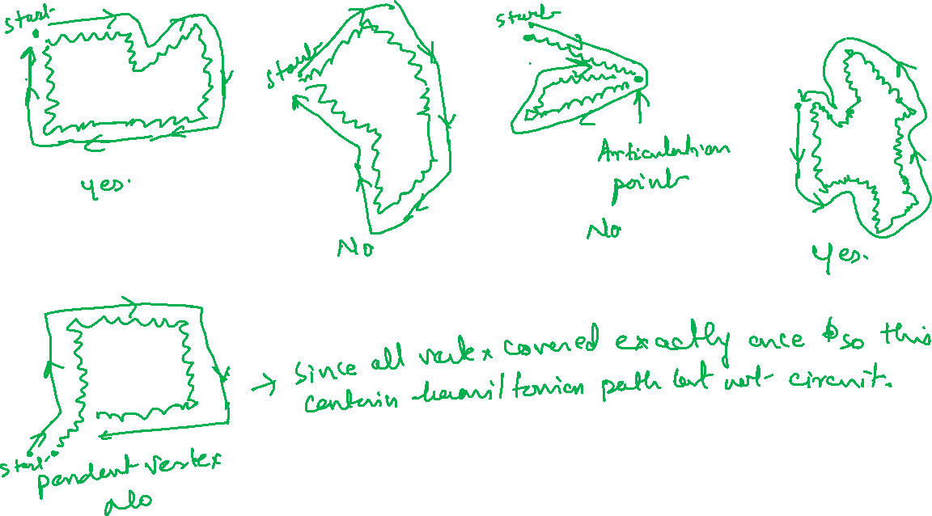

Slide 33
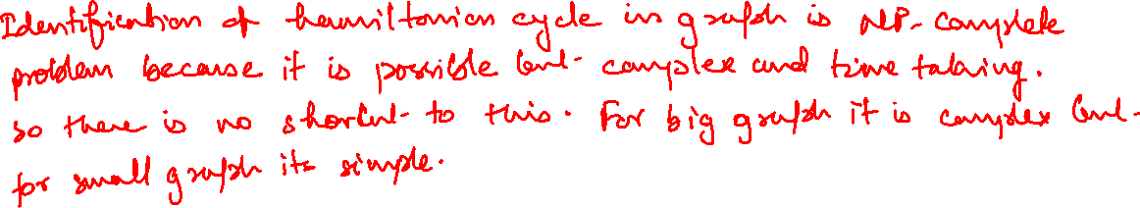
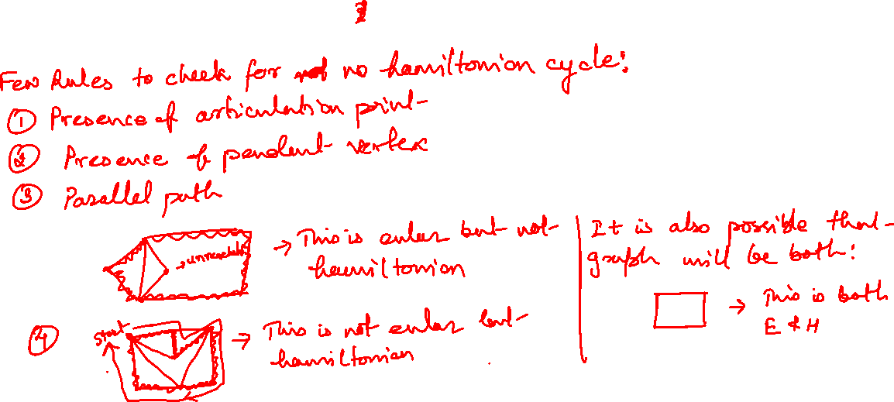

Slide 34
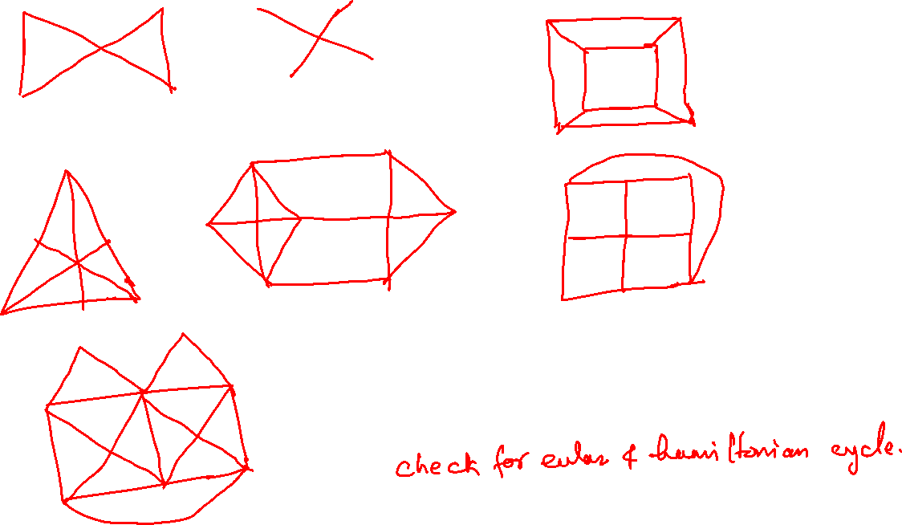

Slide 35
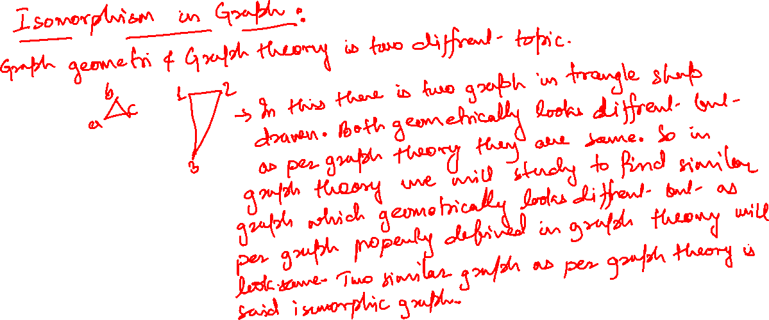

Slide 36
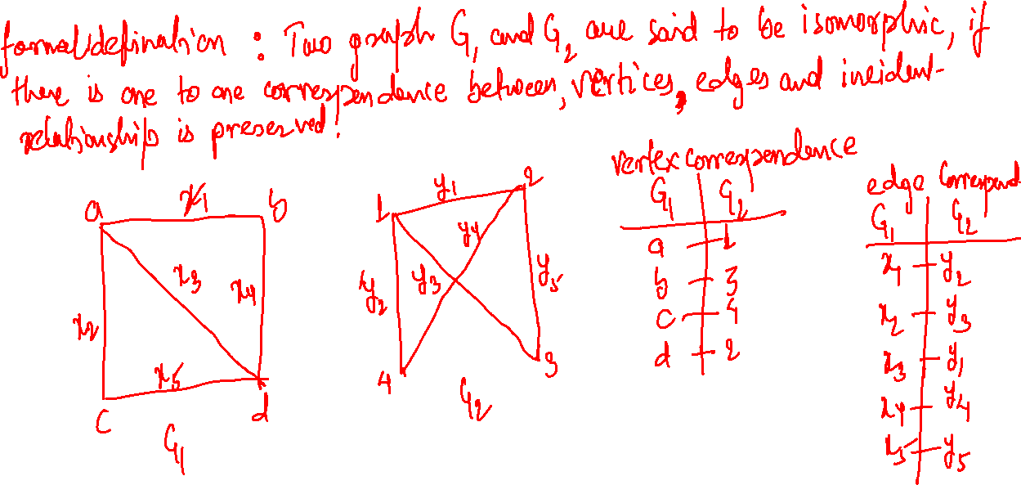

Slide 37
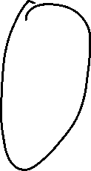

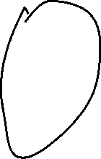

One-to-one functions
A function is one-to-one if each element in the co-domain has a unique pre-image
Meaning no 2 values map to the same result
a
e
i
o
1
2
3
4
5
a
e
i
o
1
2
3
4
5
A one-to-one function
A function that is
not one-to-one

Slide 38
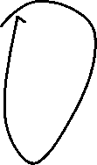



Onto functions
A function is onto if each element in the co-domain is an image of some pre-image
Meaning all elements in the right are mapped to
a
e
i
o
u
1
2
3
4
a
e
i
o
1
2
3
4
5
A function that is not onto
An onto function

Slide 39
Onto vs. one-to-one
Are the following functions onto, one-to-one, both, or neither?
a
b
c
1
2
3
4
a
b
c
d
1
2
3
4
a
b
c
1
2
3
4
1-to-1, not onto
Both 1-to-1 and onto
Not a valid function
a
b
c
d
1
2
3
a
b
c
d
1
2
3
4
Onto, not 1-to-1
Neither 1-to-1 nor onto

Slide 40
Bijections
a
b
c
d
1
2
3
4
Consider a function that is both one-to-one and onto:
Such a function is a one-to-one correspondence, or a bijection

Slide 41
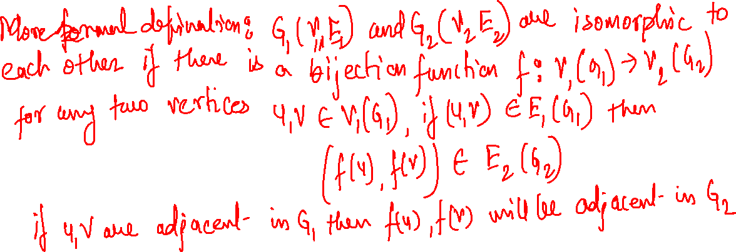
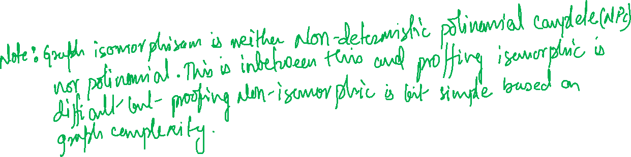

Slide 42
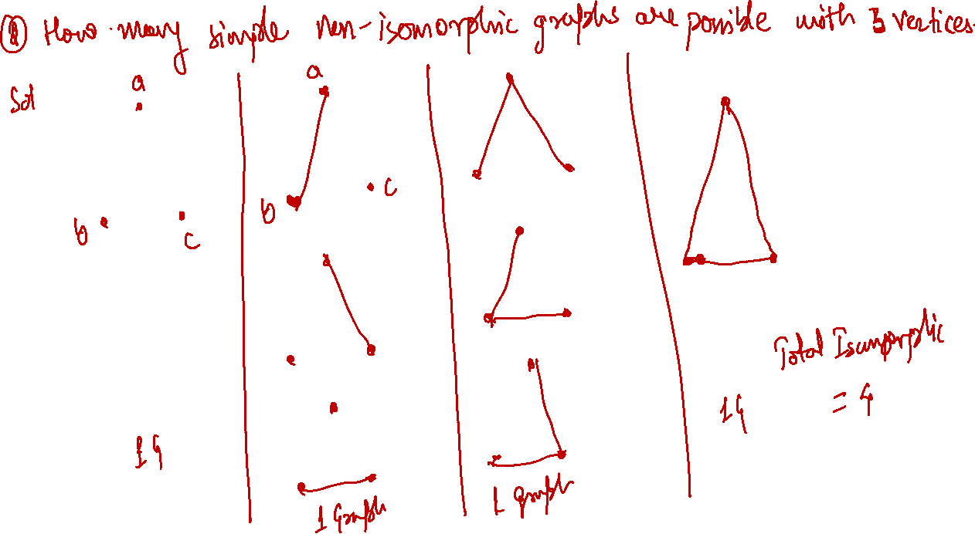

Slide 43
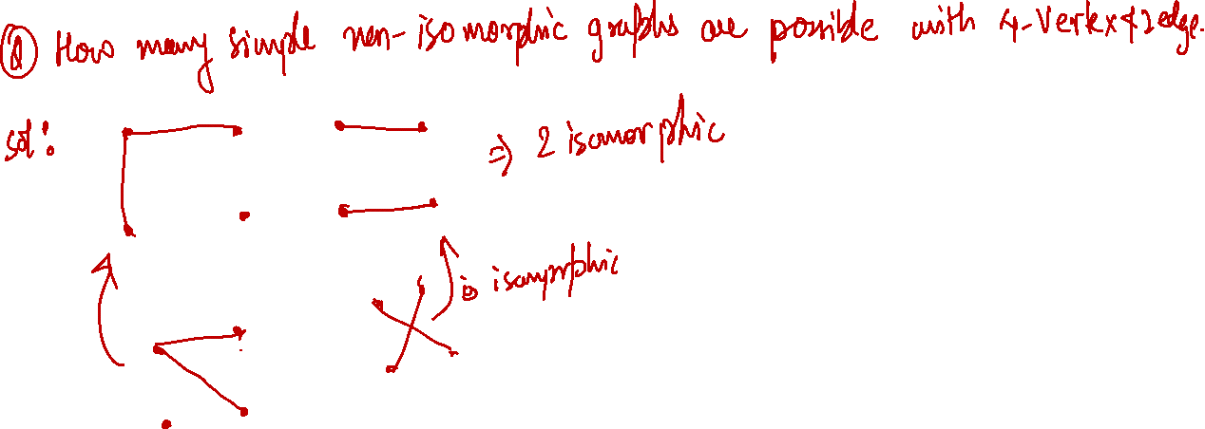

Slide 44
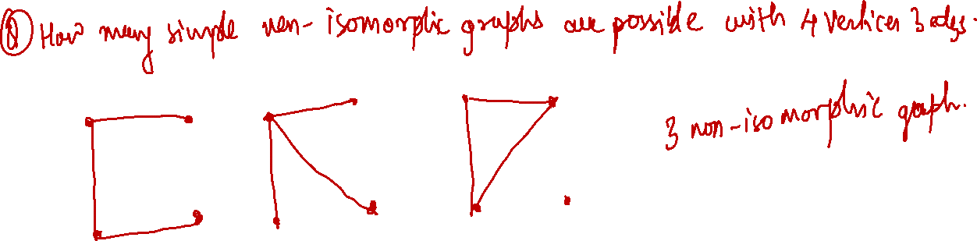

Slide 45
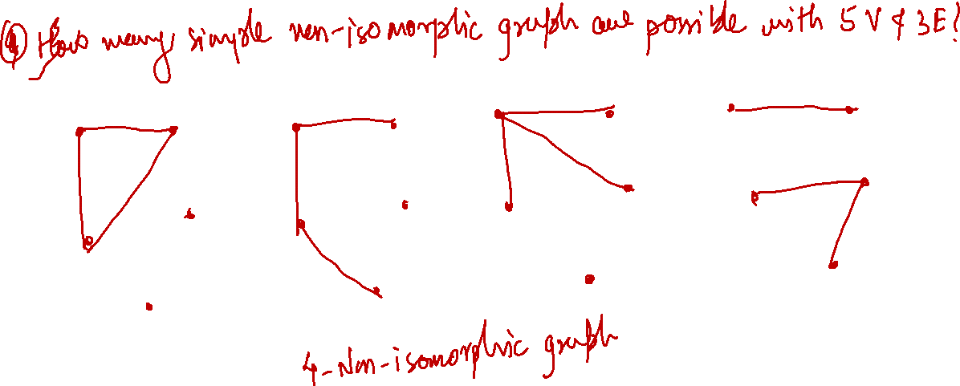

Slide 47
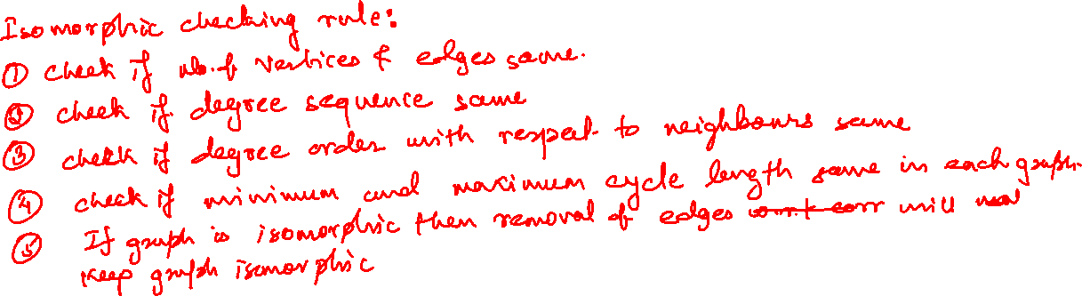

Slide 48
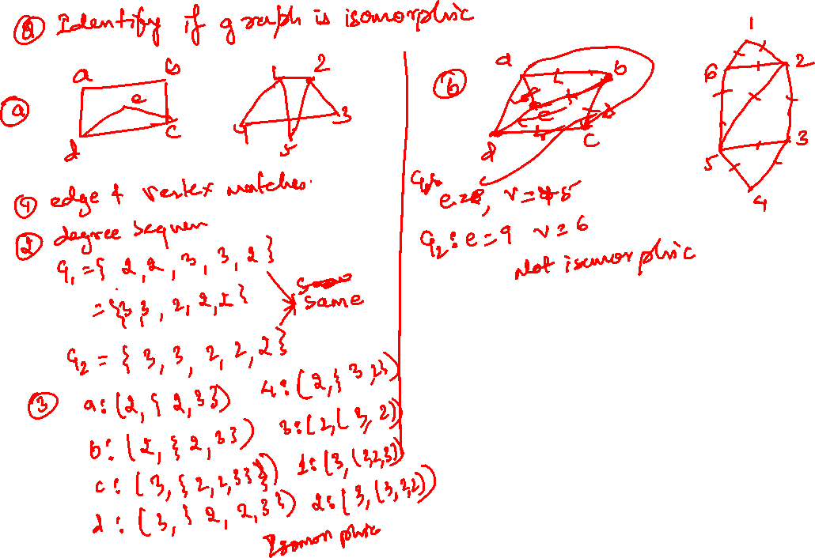

Slide 49


Slide 50


Slide 51


